Slide 1

Blockchain Ethereum Project
Covid Donation Manager

Slide 2

Introduction – Alwin Eldhose Babu
Throughout college I was interested in Coding and Cryptography, which naturally led me to Blockchain and I’ve been hooked up developing my blockchain technical skills ever since!
Professional Background:
Graduated from Sardar Patel Institute of Technology with Bachelors in Electronics Engineering
Expertise in implementing cyber solutions for clients across industries
Blockchain Background and Experience:
Led the BG-02 Apprentice Cohort as USI Coordinator, involved in day-to-day mentoring activities for BG-02 members
Associated with Blockchain Learning Guild team since 2018, developing learning content for the participants.

Slide 3
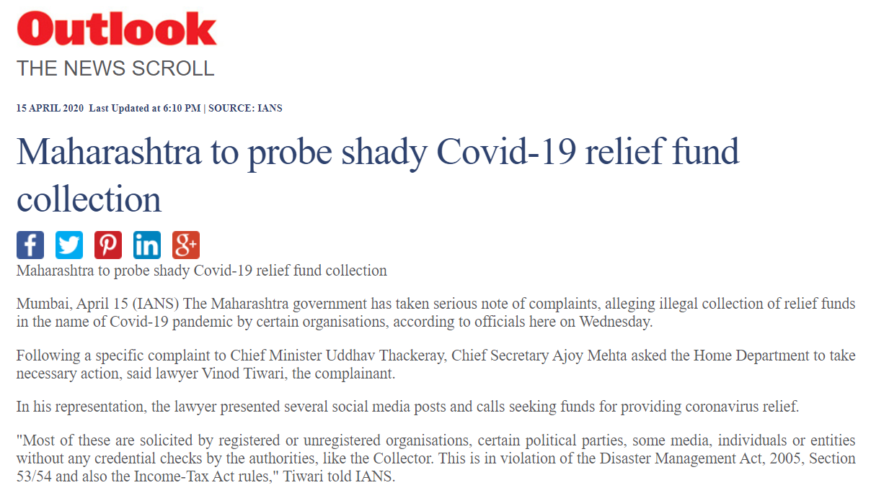
Business Case
Inspiration:
With the ongoing COVID’19 pandemic raging all over the world leaving a large section of the society vulnerable, our vision was to create an Application that could alleviate people from their suffering and contribute in a meaningful way to reduce devastating effects of Coronavirus.
Challenge:
While several Worldwide Agencies stepped in to collect funds and drive Donation Campaigns for different sections including medical workers, Covid patients. There was a spurt in unethical groups, who collected money from the well-intentioned public and used it for their personal benefits.
From this challenge arose our problem statement:
Bringing Accountability and Transparency into Donation system
Accountability: Increasing trust between Donors and Charity Organizations by introducing a system where Organizations can justify their financial decisions to the donors.
Transparency: Donors should have real time insight into how their money is being spent.

Slide 4
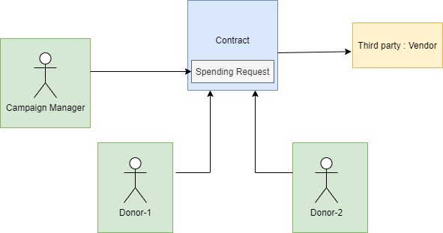
Solution: Covid Donation Manager
Ethereum based portal which allows Ether payments over a decentralized network would be the way to solve our problem.
Ether stored in our Smart-Contracts and disbursed in-accordance with principles of Accountability and Transparency
Stakeholders:
Donor : Well intentioned members of the public (like You and Me!) who wish to Donate to a trustworthy organisation
Campaign Manager: Member of Charity Organisation incharge of a specific campaign
Vendor: Third party groups responsible for delivering services/goods to the Charity for successful execution of the Campaign.

Slide 5


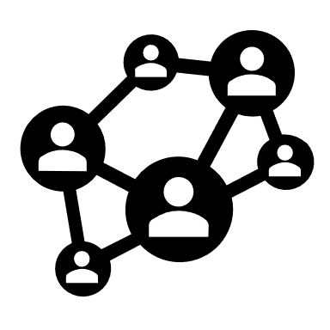

Technical Aspects
Donation
Members of the general public contributing to a Campaign fund in the form of Ether
Spending Request
Manager creating a Request to disburse certain amount of that Campaign fund to a vendor by specifying the Vendor Ether wallet address, Ether Amount, and purpose of that Expenditure
Approval
Approval from more than 50% of the Donors on a particular Spending Request
Finalisation
Manager sending over the payment to the vendor after getting approval

Slide 6
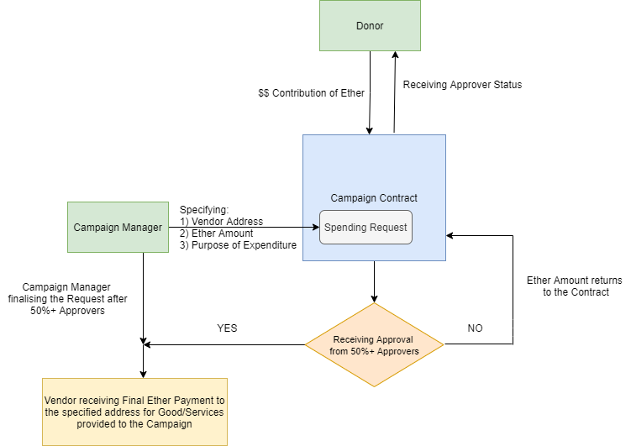
Process Flow

Slide 7




Value Addition by Blockchain
Ethereum Blockchain Solution
Decentralised Control
Donors involved have more Control and Decision making power on their part.
Transparency
Showcasing history of transactions by Campaigns to Third party vendors
Security
Ether transactions are cryptographically secured
Accountability
Charities will have to justify their financial decisions to the donors by creating Spending Requests.

Slide 8
Smart Contract
Major Functions:
Function Names | Description
Campaign | Constructor function that sets the minimum Contribution and the owner
Contribute | Called when someone wants to donate money to Charity and become an approver
CreateRequest | Called by manager to create new spending request
ApproveRequest | Called by each contributer to approve spending request
FinaliseRequest | After a request has got enough approvers, manager can call this to get money sent to a vendor
Variables:
Major Variables | DataType | Description
Manager | address | address of person who's managing the contract
Minimum Contribution | uint | Min donation required to be considered an Approver
Approver | address[] | List of addresses for every person who has donated money
Requests | request[] (Struct) | List of requests that Manager has created

Slide 9
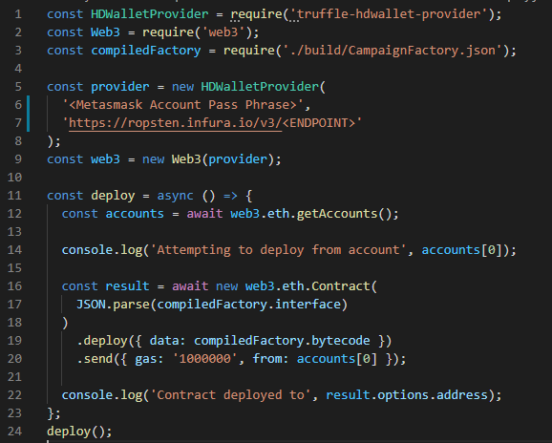
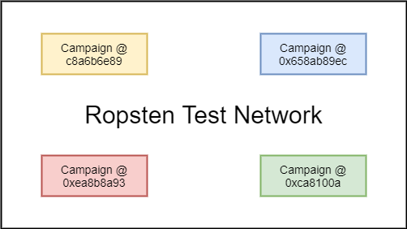
Deploy Campaign on Ethereum Network
Tools Used to Deploy Contract
HDWalletProvider: To handle the transaction signing as well as the connection to the Ethereum network.
Infura: Helps to connect easily to Web 3.0 without having to spin-up and maintain our own infrastructure
Ethereum Network Used
Ropsten Test Network: Allows blockchain developers to test their work in a live setting, but without the need for real ETH

Slide 10
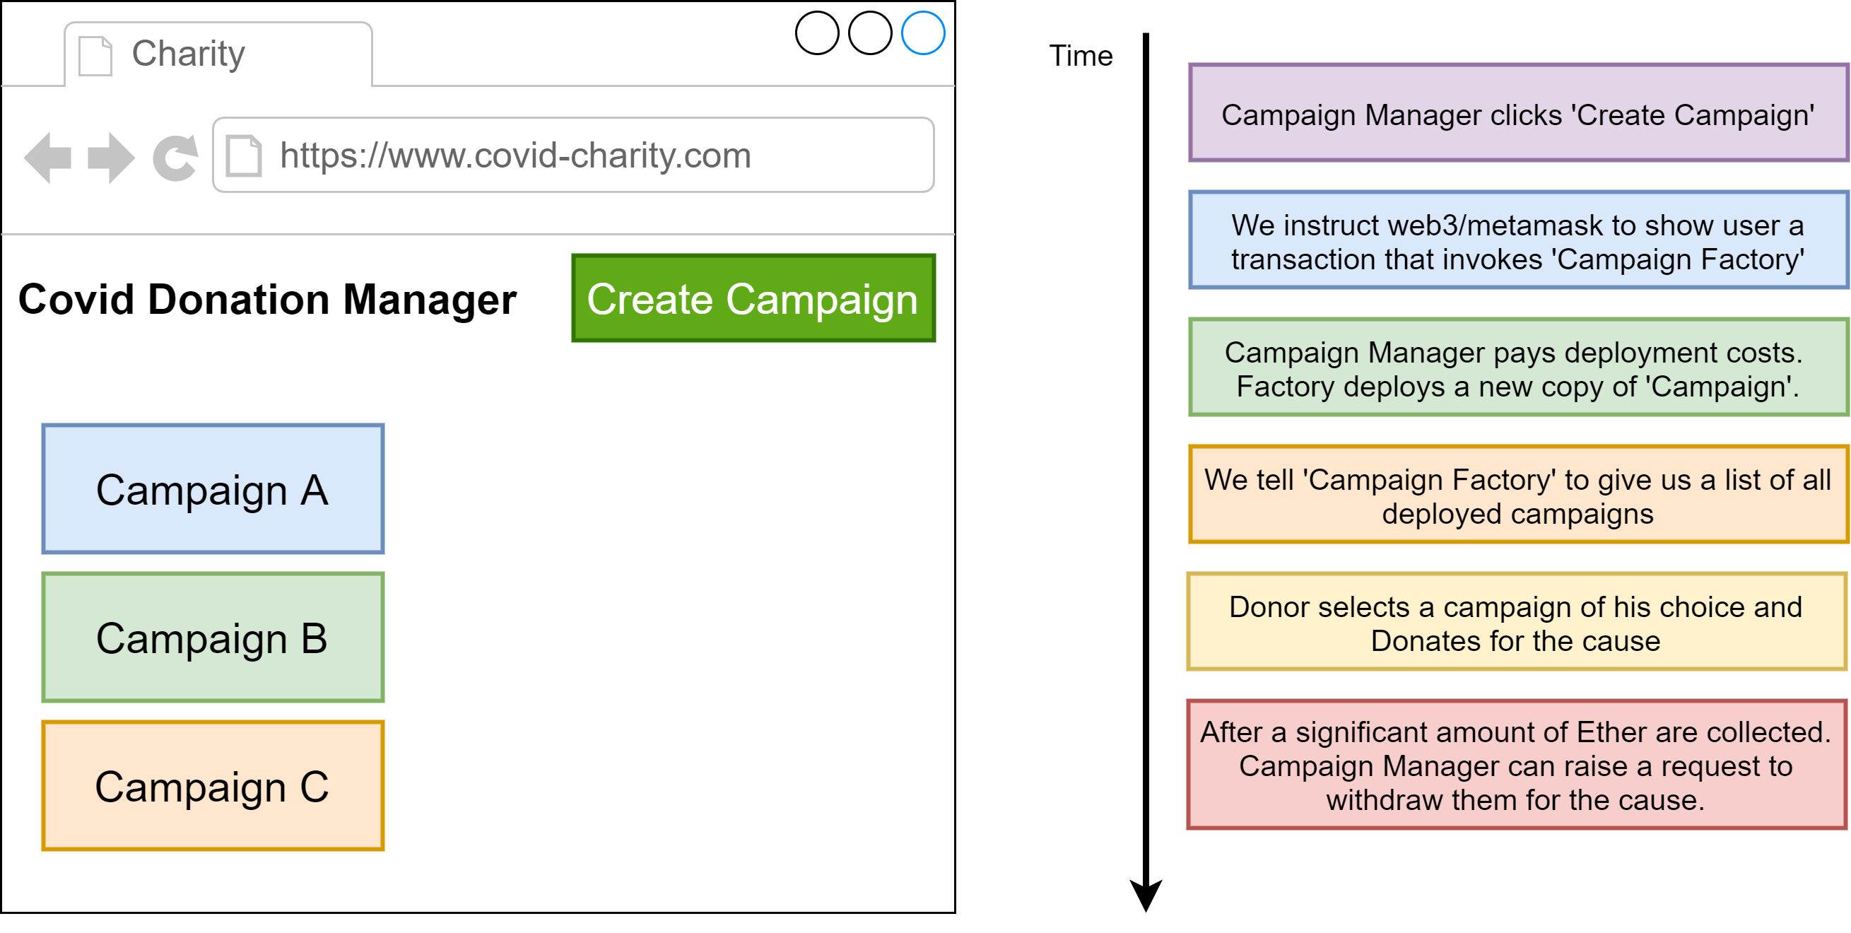
Front-end Flow

Slide 11





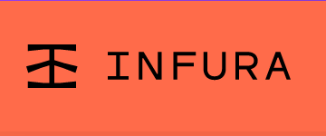

Tools Used
Front-end
IDE
Back-end
Collaboration Tool
Deployment
Wallet Provider

Slide 12
Live Demonstration
Video Attached

Slide 13




Future Development Aspects
Introducing the component of time and deadlines, so that if approvals don’t get confirmed in a specific time-frame, the Spending Requests become null and void and Ether amount gets returned to donor account
Associating each Campaign address with the Campaign purpose for better visualization to viewers.
For scalability, when more users access the Application, then we can deploy it on AWS with auto-scaling to cater to the demands of new users.

